Slide 1
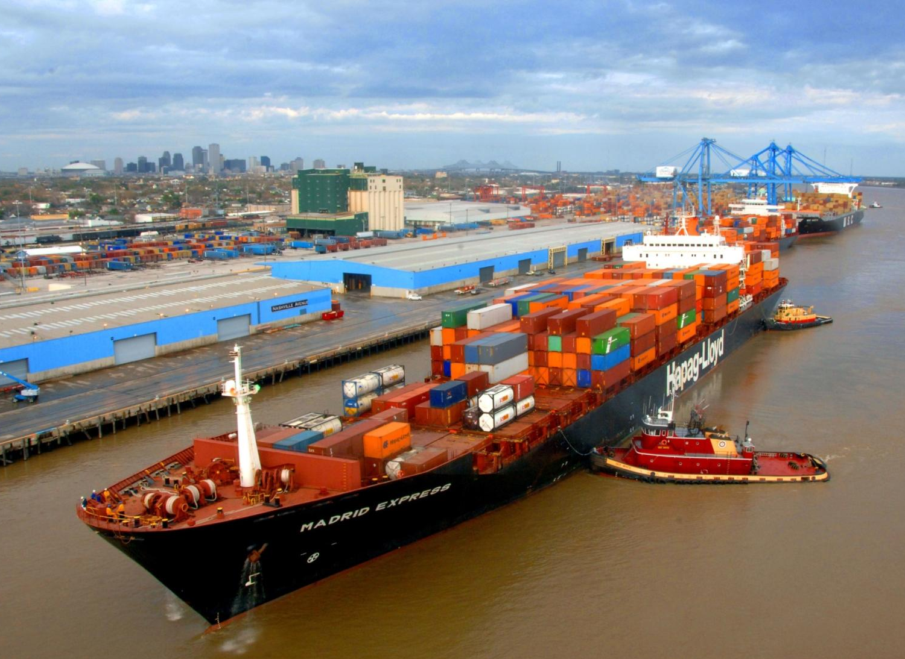
Around the Bend
Trends Affecting the Growth of the Port of New Orleans
Chris Bonura
Director of Industrial Development
Port of New Orleans
Hydrographic Services Review Panel
28 November 2012

Slide 2
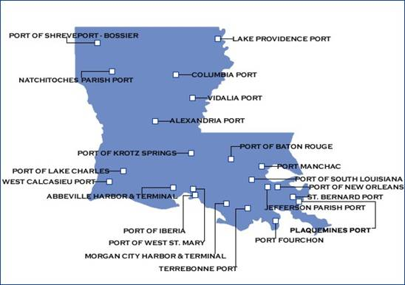
Louisiana’s Ports
Louisiana has six deepwater ports.
396,000 people employed because of La’s maritime infrastructure & related industries.
One in five jobs in La. are dependent on waterways.
Source: PAL, DOTD
Notes:
With five port authorities and four pilot organizations on the Lower Mississippi River, there is no centralized authority that governs the river.
Has complicated the funding of the PORTS system.
However, despite the lack of central control, the Louisiana Port system is used to collaboration.
Found a way to put PORTS system on a stable financial footing and collect user fee through the Bar Pilots. All foreign flagged deep draft vessels entering the river use the bar pilots.
Still not perfect– no mechanism to collect from shallow draft or U.S. flag deep draft users.

Slide 3
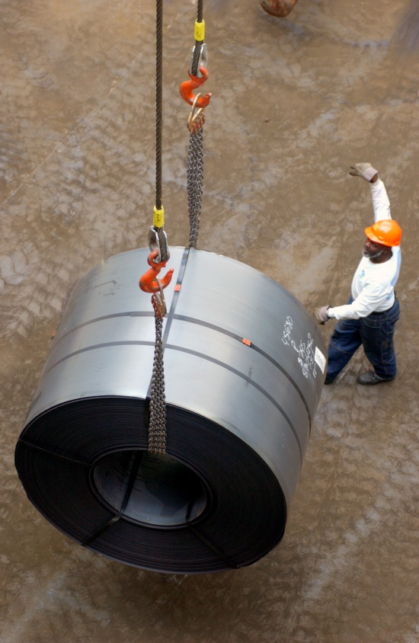
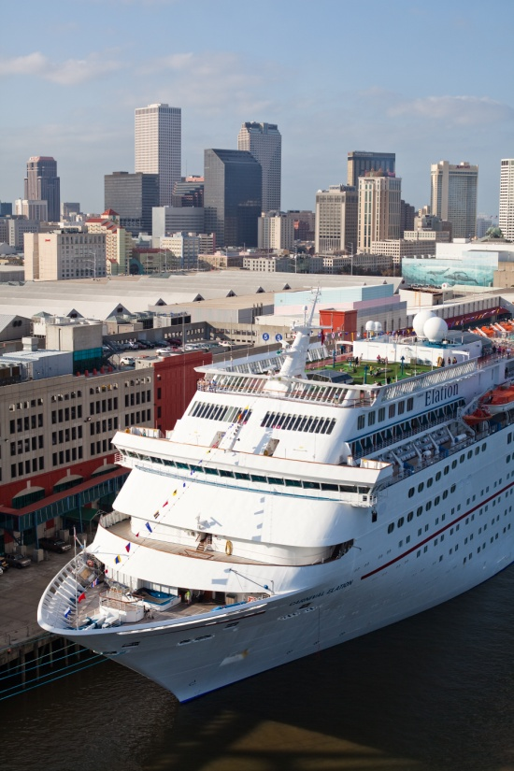
Business Profile
Breakbulk Cargo
  Traditional Breakbulk
  Heavy Lift/ Project Cargo
  Refrigerated Cargo
Container Cargo
Cruise
Industrial Property
Notes:
72% cargo operations
20% cruise operations
8% industrial real estate
Of the cargo operations-
63% of our volume is container
37% is breakbulk
2007 was practically even- container volumes have grown, whereas breakbulk totals have been mostly flat

Slide 4
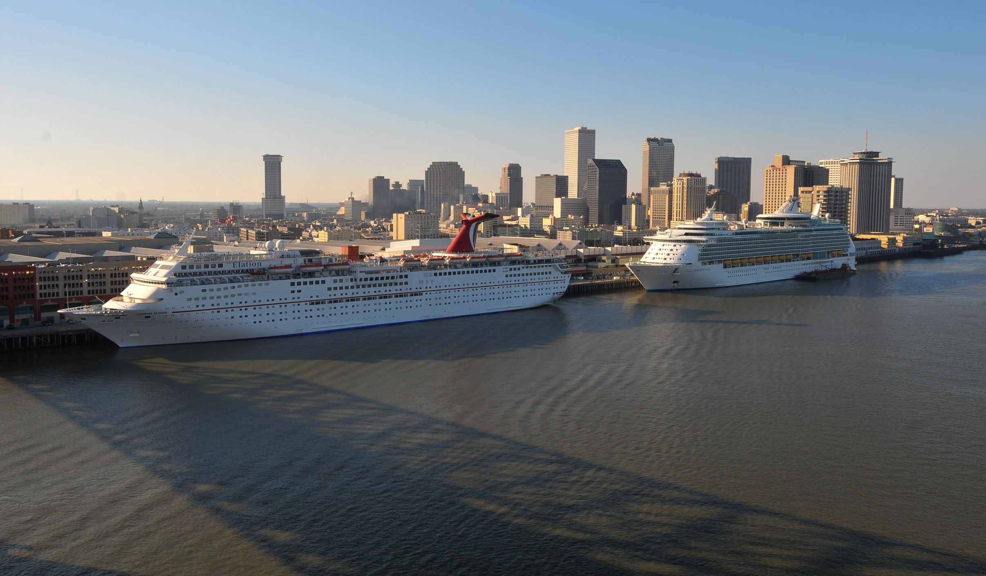
Cruise Ships:
Larger Ships Drive Growth
Notes:
RCCL Navigator of the Seas- Largest Cruise Ship to Call New Orleans-
Length 1,020 and 3,114 passengers
Norwegian Cruise Lines- recently replaced the Norwegian Spirit with the Norwegian Star, increased their passenger load by 16%

Slide 5
Cruise Passenger Trend

Slide 6
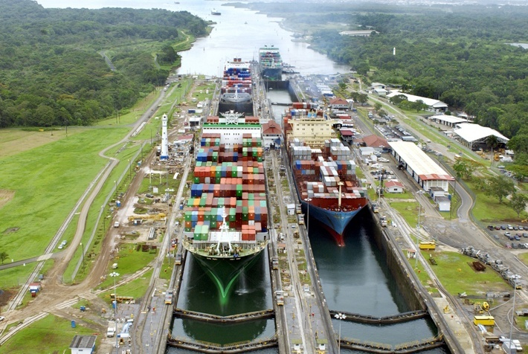
Preparing for Panama
Balancing Capacity Growth with a Realistic View of the Market Opportunity
Notes:
Late 2014
Depth 39.5 feet ➔ 50 feet
Max ship size 4,500➔ 12,000
New Orleans- Channel and container terminal both at 45 feet.
Already have “post-panamax” vessels coming from Europe, EC of South America
8,000 TEU
Should also have a big impact in terms of Bulk shipments, which will use every inch of draft available to them.

Slide 7
Gulf Ports Container Capacity
 | 2011 TEUs | Capacity | Expansion capacity | Draft | Draft Plans | Gantry Cranes
Houston | 1.86 M | 2.7 M | 4.0 M | 40 | 45 | 22
NOLA | 477,000 | 600,000 | 1.6 M | 45 | 50 | 6
Gulfport | 216,000 | 300,000 | 1 M | 36 | 42 to 45 | 0 *
Mobile | 170,000 | 350,000 | 800,000 | 45 |  | 2
Freeport | 57,000 | 100,000 | 800,000 | 45 | 55 | 0*
Tampa | 40,000 | 175,000 | 800,000 | 43 |  | 3
Gulfport and Freeport are currently using two mobile harbor cranes to handle container moves.

Slide 8
Panama Canal Trade Lane Volume
Source: AT Kearney
Notes:
Gulf Coast will benefit from the increased volume of the Panama Canal based on current volumes, but not to the same extent as the East Coast since the Atlantic Ports have a bigger share of Panama Canal volumes.
ACP volume will grow from 12.3 M TEU to 25.4 M TEU
East Coast volume will grow from 6.7 M TEU to 13.7 M TEU
Gulf Coast Volume will grow from 1.5 M TEU to 3 M TEU.
Suggest that there are about 1.5 M TEUs up for grab among six ports in Gulf over the next 15 years. Nothing to sneeze at, but not nearly as big as the opportunity on the East Coast.
Our goal is to reach 1 million TEUs (about double our existing volume), by gaining some of the expanded Panama business and by growing our volumes from other trade lanes.

Slide 9
Projected Volume Increases
Source: AT Kearney
Notes:
ACP volume will grow from 12.3 M TEU to 25.4 M TEU
East Coast volume will grow from 6.7 M TEU to 13.7 M TEU
Gulf Coast Volume will grow from 1.5 M TEU to 3 M TEU.
Suggest that there are about 1.5 M TEUs up for grab among six ports in Gulf over the next 15 years. Nothing to sneeze at, but not nearly as big as the opportunity on the East Coast.
Gulf Coast will also likely see growth from trade routes that don’t require a Panama Canal transit.
Personally, I think AT Kearney’s numbers are a little too conservative, since they were calculated during the recession.
We will continue to make incremental investments as we have opportunities.
We have the permits and footprint in place to double our current capacity if the market dictates that we can.

Slide 10
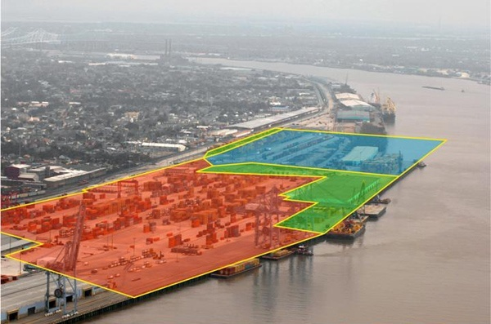
Container Terminal Expansion
Red | Existing | 594,000 TEUs
Green | Phase 2 | 194,000 TEUs
Blue | Phase 3 | 800,000 TEUs
Total |  | 1.58M TEUs

Slide 11
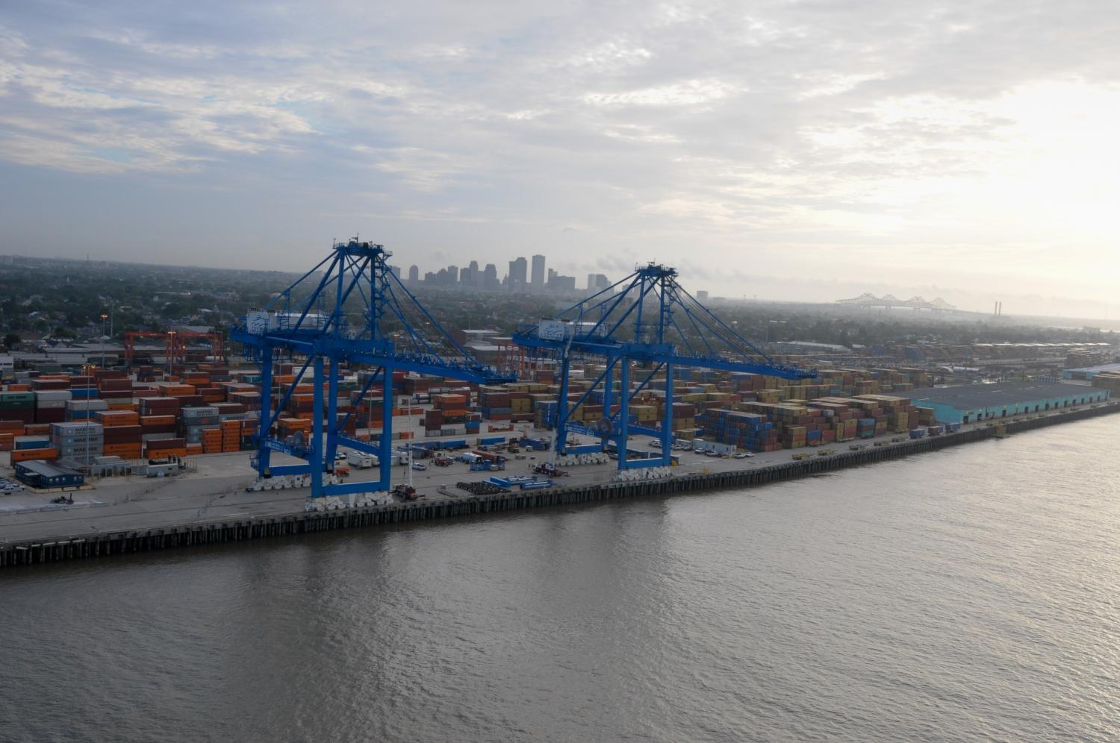
New Gantry Cranes
Notes:
New post-panamax cranes will have the ability to reach across 19 columns of containers for wider ships transiting the Panama Canal.
Compare to our existing cranes with the ability to reach 15 across.
Dedicated 5 additional acres of marshalling yard that expands our capacity by 45,000 TEUs/year.
Together, these projects represent a $37 million investment in port infrastructure.
Breaking up phase 2 into incremental projects so that we don’t get too far ahead of market demand.

Slide 12
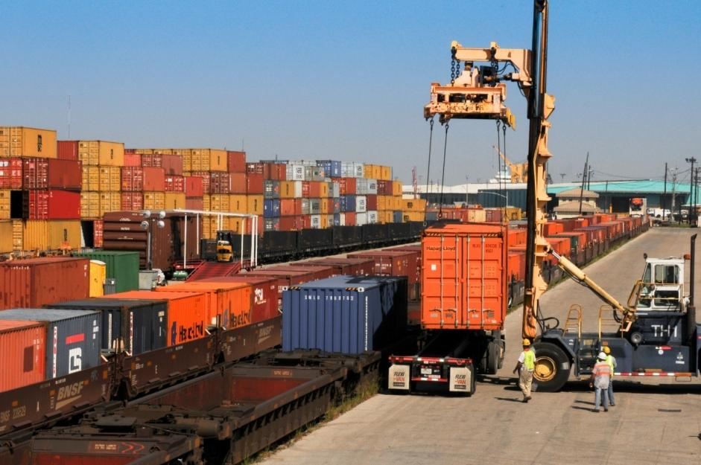
Napoleon Intermodal Railyard
Existing rail terminal allows us to move containers on rail to/from Napoleon.
Received $16.7 million federal transportation grant to rebuild rail yard.
New layout will be more efficient and give us more room to expand the container terminal.
Notes:
Next increment of investment: Napoleon Intermodal Railyard.
Currently can reach Memphis in 1 day, Chicago in 2 and Detroit in 3 on Canadian National Intermodal rail service.

Slide 13
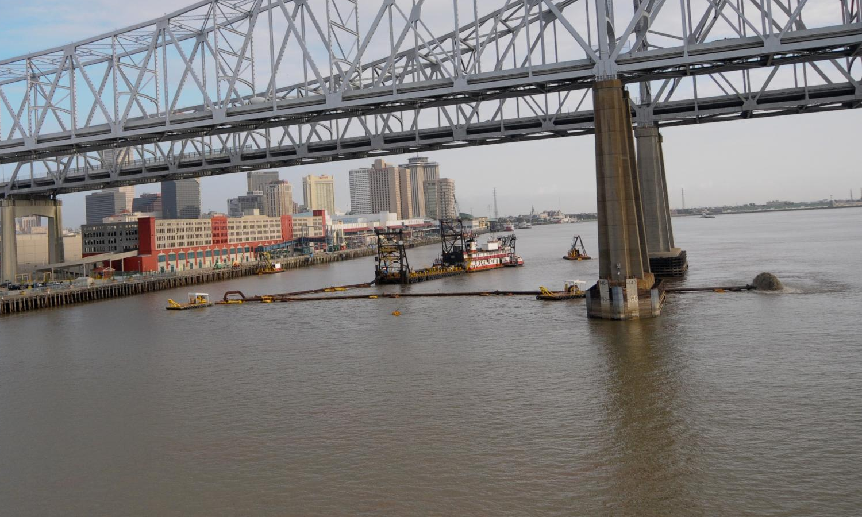
Harbor Maintenance
Before ports can expand, they must fight to maintain the status quo

Slide 14

Harbor Maintenance Issues
30 % of vessel calls in U.S. Ports constrained by inadequate channel dimensions.
$1.3 B - $1.6 B per year collected from Harbor Maintenance Tax , but about half is spent for intended purpose.
RAMP Act would put a lockbox on HMTF.

Slide 15
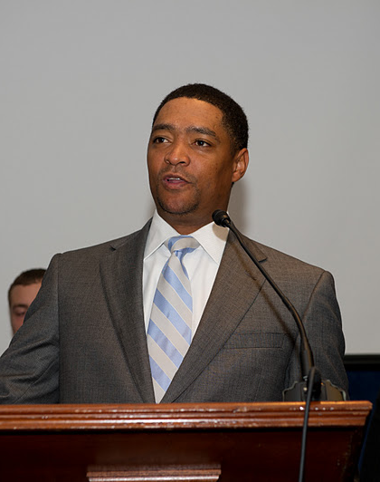
DREDGE Act of 2012
55-foot channel authorized 40 years ago.
Funds never appropriated.
DREDGE Act , sponsored by Rep. Richmond, would construct a 50 foot channel.
Beneficial use pilot project.

Slide 16
Around the Bend
Trends Affecting the Growth of the Port of New Orleans
Chris Bonura
Director of Industrial Development
Port of New Orleans
Hydrographic Services Review Panel
28 November 2012

Slide 17
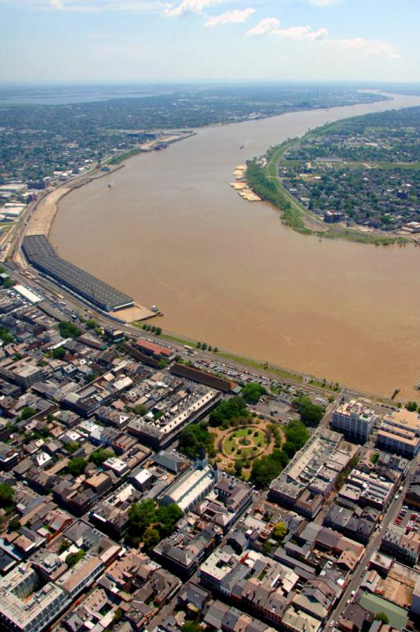
Keeping the Mississippi Mighty
Takes roughly $100 M annually to maintain the Mississippi.
Funded at about $60 M.
Channel dimensions have shrunk as low as 42 feet deep x 200 feet wide
Over 20% of U.S. waterborne commerce flows on the Lower Miss.
Notes:
Conclusion of Section:
Need to put a lock box on Harbor Maintenance Tax so that we can focus as a maritime nation on improving our Port infrastructure, not just struggling to maintain the status quo.
Boustany is making progress on the RAMP Act, urge all to support it.
Invite to join the Big River Coalition.

